Slide 1
AI 전문가 과정 – PointNet 구현
PointNet
3D point cloud classification
https://github.com/shuuwook/PointCloud-Tutorial-1
PointNet: Deep Learning on Point Sets for 3D Classification and Segmentation
CVPR 2017, Charles R*. Qi, Hao Su*, Kaichun Mo, Leonidas J. Guibas

Slide 2
AI 전문가 과정 – PointNet 구현
PointNet
https://github.com/shuuwook/PointCloud-Tutorial-1

Slide 3
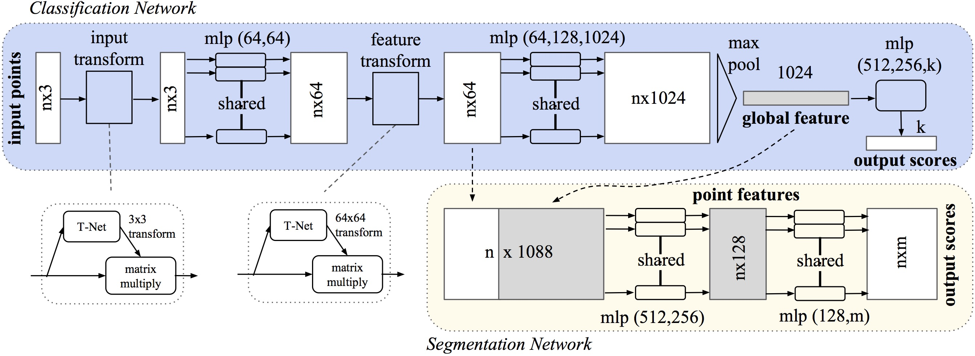
AI 전문가 과정 – PointNet 구현
- PointNet architecture

Slide 4
AI 전문가 과정 – PointNet 구현
- PointNet classification
MLP, T-Net, MaxPooling

Slide 5
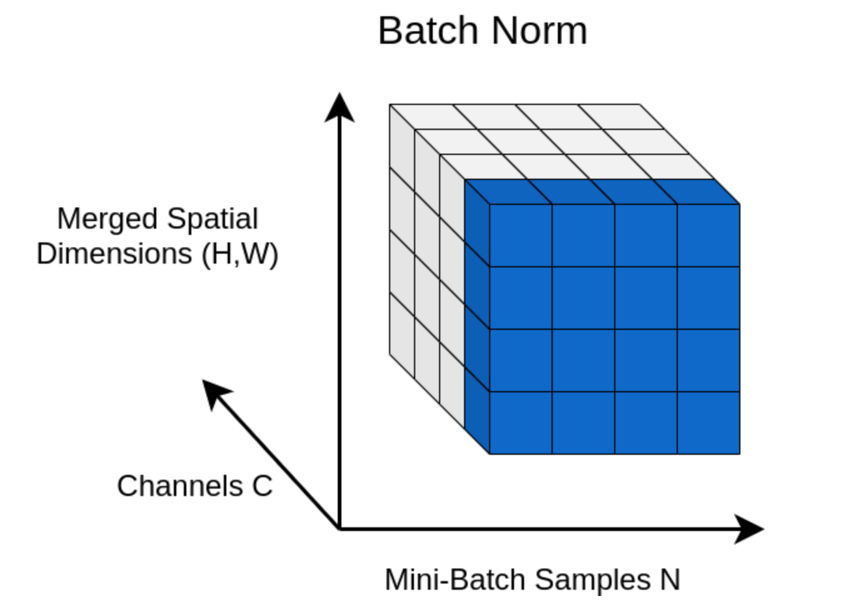
AI 전문가 과정 – PointNet 구현
- PointNet classification : BatchNorm for 3D point clouds 구현
(B, C, H, W) input > nn.BatchNorm2d(C) > (B, C, H, W) output
(B, C, H*W) input > nn.BatchNorm1d(C) > (B, C, H*W) output
(B, N, C) input > nn.BatchNorm1d(C) > (B, C, N) output

Slide 6
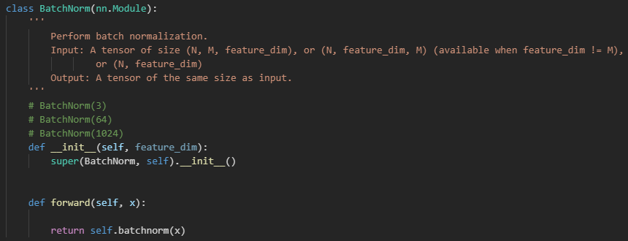
AI 전문가 과정 – PointNet 구현
- PointNet classification : BatchNorm for 3D point clouds 구현
Input : (B, C, N)
BatchNorm1d : nn.BatchNorm1d(C)
Output : (B, C, N)

Slide 7
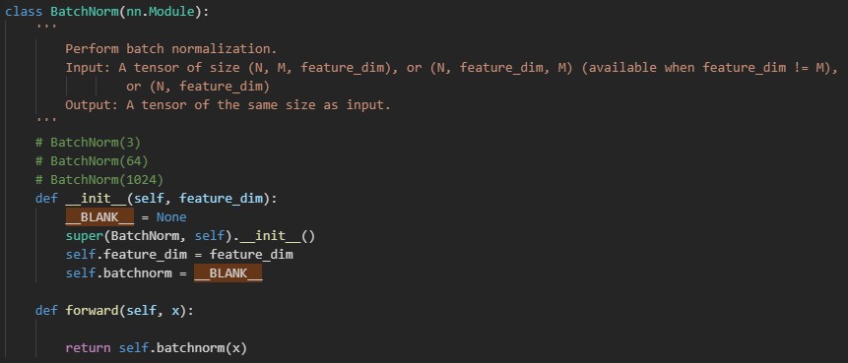
AI 전문가 과정 – PointNet 구현
- PointNet classification : BatchNorm for 3D point clouds 구현
Input : (B, C, N)
BatchNorm1d : nn.BatchNorm1d(C)
Output : (B, C, N)

Slide 8
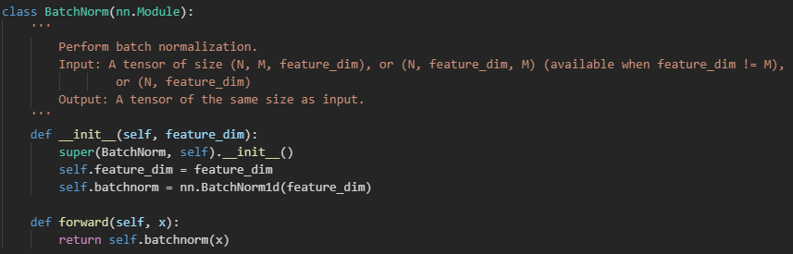
AI 전문가 과정 – PointNet 구현
- PointNet classification : BatchNorm for 3D point clouds 구현
Input : (B, C, N)
BatchNorm1d : nn.BatchNorm1d(C)
Output : (B, C, N)

Slide 9
AI 전문가 과정 – PointNet 구현
- PointNet classification : Permute for 3D point clouds 구현
(B, C, H, W) input > nn.BatchNorm2d(C) > (B, C, H, W) output
(B, C, H*W) input > nn.BatchNorm1d(C) > (B, C, H*W) output
(B, N, C) input > (B, C, N) > nn.BatchNorm1d(C) > (B, C, N) > (B, N, C) output

Slide 10
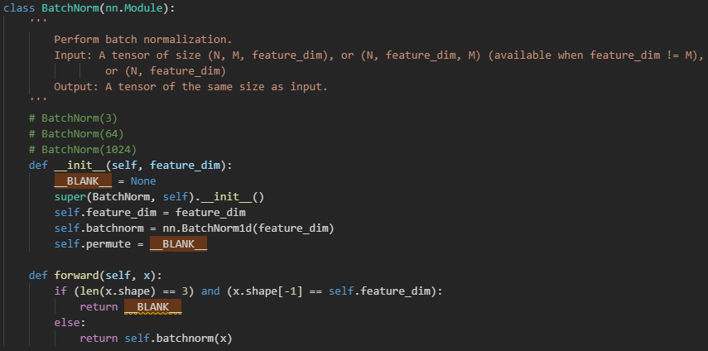
AI 전문가 과정 – PointNet 구현
- PointNet classification : Permute for 3D point clouds 구현
(B, N, C) > (B, C, N)
(B, C, N) > (B, N, C)
Permute((?, ?, ?))

Slide 11
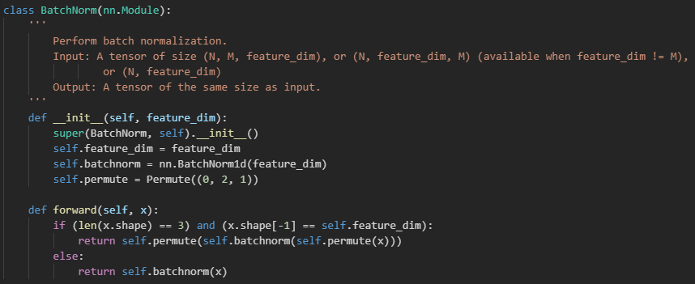
AI 전문가 과정 – PointNet 구현
- PointNet classification : Permute for 3D point clouds 구현
(B, N, C) > (B, C, N)
(B, C, N) > (B, N, C)
Permute((?, ?, ?))

Slide 12
AI 전문가 과정 – PointNet 구현
- PointNet classification : Shared MLP 구현
Fully-connected layer
Batch normalization
ReLU activation function
Fully-connected layer
Batch normalization
ReLU activation function
Fully-connected layer
Batch normalization
ReLU activation function
: (N, IN) > (N, D)
: (N, D) > (N, D)
: (N, D) > (N, D)
: (N, D) > (N, D)
: (N, D) > (N, D)
: (N, D) > (N, D)
: (N, D) > (N, D)
: (N, D) > (N, D)
: (N, D) > (N, OUT)
n x 3
n x 64
n x 64
n x 64
n x 64
n x 64

Slide 13
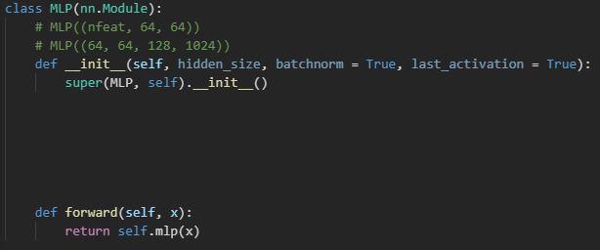
AI 전문가 과정 – PointNet 구현
- PointNet classification : Shared MLP 구현
Fully-connected layer
Batch normalization
ReLU activation function
Fully-connected layer
Batch normalization
ReLU activation function
Fully-connected layer
Batch normalization
ReLU activation function
: (N, IN) > (N, D)
: (N, D) > (N, D)
: (N, D) > (N, D)
: (N, D) > (N, D)
: (N, D) > (N, D)
: (N, D) > (N, D)
: (N, D) > (N, D)
: (N, D) > (N, D)
: (N, D) > (N, OUT)

Slide 14
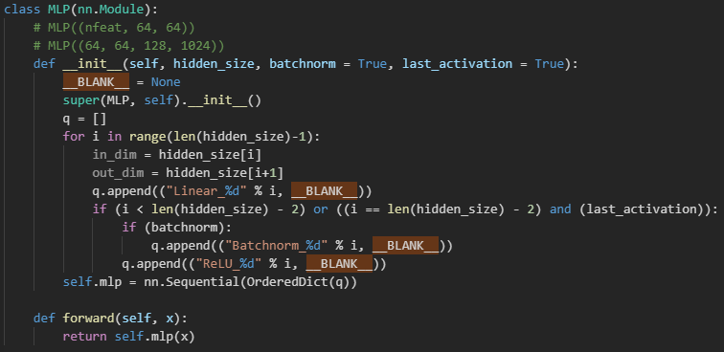
AI 전문가 과정 – PointNet 구현
- PointNet classification : Shared MLP 구현
Fully-connected layer
Batch normalization
ReLU activation function
Fully-connected layer
Batch normalization
ReLU activation function
Fully-connected layer
Batch normalization
ReLU activation function
: (N, IN) > (N, D)
: (N, D) > (N, D)
: (N, D) > (N, D)
: (N, D) > (N, D)
: (N, D) > (N, D)
: (N, D) > (N, D)
: (N, D) > (N, D)
: (N, D) > (N, D)
: (N, D) > (N, OUT)

Slide 15
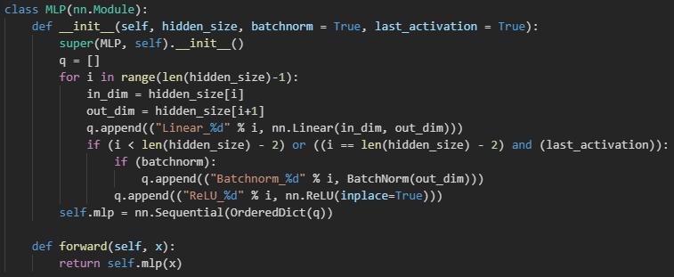
AI 전문가 과정 – PointNet 구현
- PointNet classification : Shared MLP 구현
Fully-connected layer
Batch normalization
ReLU activation function
Fully-connected layer
Batch normalization
ReLU activation function
Fully-connected layer
Batch normalization
ReLU activation function
: (N, IN) > (N, D)
: (N, D) > (N, D)
: (N, D) > (N, D)
: (N, D) > (N, D)
: (N, D) > (N, D)
: (N, D) > (N, D)
: (N, D) > (N, D)
: (N, D) > (N, D)
: (N, D) > (N, OUT)

Slide 16
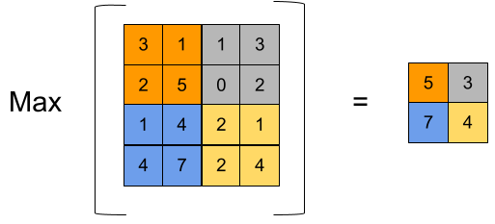
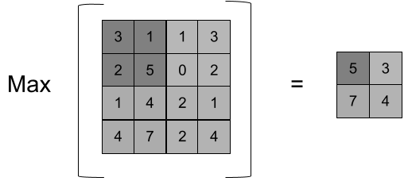

AI 전문가 과정 – PointNet 구현
- PointNet classification : Global max pooling 구현

Slide 17
AI 전문가 과정 – PointNet 구현
- PointNet classification : Global max pooling 구현
Max : (B, N, 1024) > (B, 1024)

Slide 18
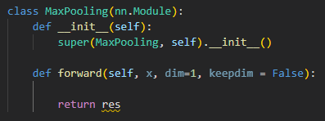
AI 전문가 과정 – PointNet 구현
- PointNet classification : Global max pooling 구현
Max : (B, N, 1024) > (B, 1024)

Slide 19
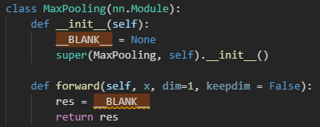
AI 전문가 과정 – PointNet 구현
- PointNet classification : Global max pooling 구현
Max : (B, N, 1024) > (B, 1024)

Slide 20
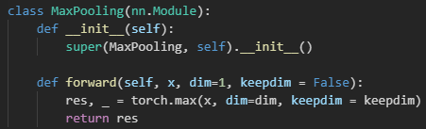
AI 전문가 과정 – PointNet 구현
- PointNet classification : Global max pooling 구현
Max : (B, N, 1024) > (B, 1024)

Slide 21
AI 전문가 과정 – PointNet 구현
- PointNet classification : Transform module 구현
Transform network (T-Net) ?
1. Permutation invariant → (n! 경우의 수는 모두 동일)
2. Rigid motion invariant → (점 사이의 상대적 거리와 방향 유지) → Translation, Rotation, Reflection

Slide 22
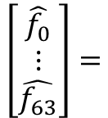
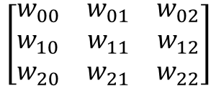

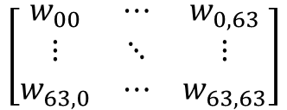
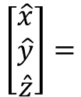

AI 전문가 과정 – PointNet 구현
- PointNet classification : Transform module 구현
$$\left[\begin{matrix}\hat{x} \\ \hat{y} \\ \hat{z}\end{matrix}\right]=$$
$$\left[\begin{matrix}w_{00} & w_{01} & w_{02} \\ w_{10} & w_{11} & w_{12} \\ w_{20} & w_{21} & w_{22}\end{matrix}\right]$$
$$\left[\begin{matrix}x \\ y \\ z\end{matrix}\right]$$
$$\left[\begin{matrix}\hat{f_{0}} \\ ⋮ \\ \hat{f_{63}}\end{matrix}\right]=$$
$$\left[\begin{matrix}w_{00} & ⋯ & w_{0,63} \\ ⋮ & ⋱ & ⋮ \\ w_{63,0} & ⋯ & w_{63,63}\end{matrix}\right]$$
$$\left[\begin{matrix}f_{0} \\ ⋮ \\ f_{63}\end{matrix}\right]$$

Slide 23
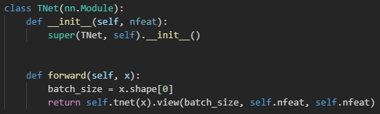
AI 전문가 과정 – PointNet 구현
- PointNet classification : Transform module 구현
MLP
MaxPooling
BatchNorm
MLP
Reshape
: (N, IN) > (N, 64) > (N, 128) > (N, 1024)
: (N, 1024) > (1024,)
: (B, 1024) > (B, 1024)
: (B, 1024) > (B, 512) > (B, 256) > (B, IN*IN)
: (B, IN*IN) > (B, IN, IN)

Slide 24
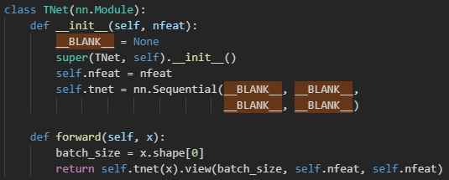
AI 전문가 과정 – PointNet 구현
- PointNet classification : Transform module 구현
MLP
MaxPooling
BatchNorm
MLP
Reshape
: (N, IN) > (N, 64) > (N, 128) > (N, 1024)
: (N, 1024) > (1024,)
: (B, 1024) > (B, 1024)
: (B, 1024) > (B, 512) > (B, 256) > (B, IN*IN)
: (B, IN*IN) > (B, IN, IN)

Slide 25
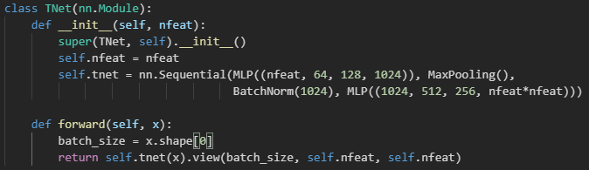
AI 전문가 과정 – PointNet 구현
- PointNet classification : Transform module 구현
MLP
MaxPooling
BatchNorm
MLP
Reshape
: (N, IN) > (N, 64) > (N, 128) > (N, 1024)
: (N, 1024) > (1024,)
: (B, 1024) > (B, 1024)
: (B, 1024) > (B, 512) > (B, 256) > (B, IN*IN)
: (B, IN*IN) > (B, IN, IN)

Slide 26
AI 전문가 과정 – PointNet 구현
- PointNet classification : PointNet 구현
Global Maxpool
TNet
BatchNorm
MLP
TNet
BatchNorm
MLP
BatchNorm
MLP
+
Dropout
Linear

Slide 27
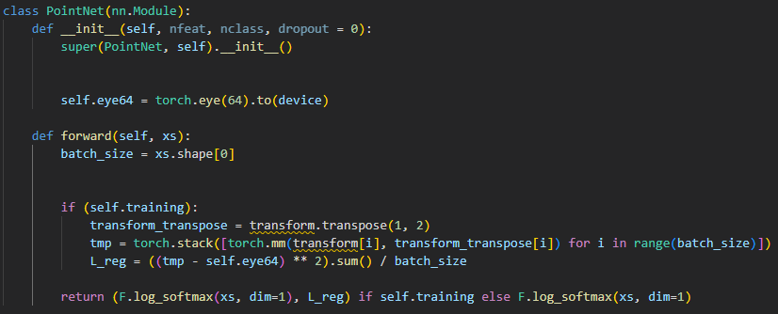

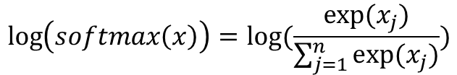
AI 전문가 과정 – PointNet 구현
- PointNet classification : PointNet 구현
$$\log\left(softmax\left(x\right)\right)=log⁡(\frac{exp⁡(x_{j})}{\sum_{j=1}^{n}{exp⁡(x_{j})}})$$

Slide 28
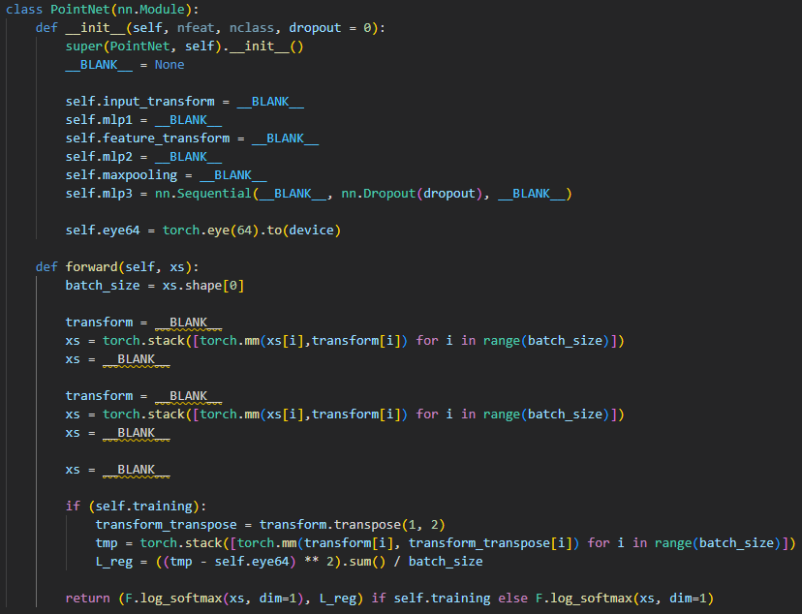
AI 전문가 과정 – PointNet 구현
- PointNet classification : PointNet 구현

Slide 29
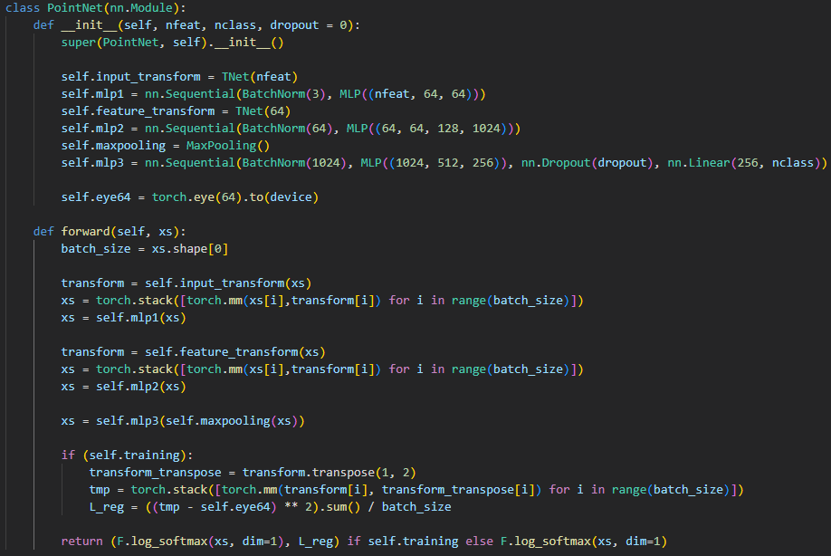
AI 전문가 과정 – PointNet 구현
- PointNet classification : PointNet 구현

